Slide 1
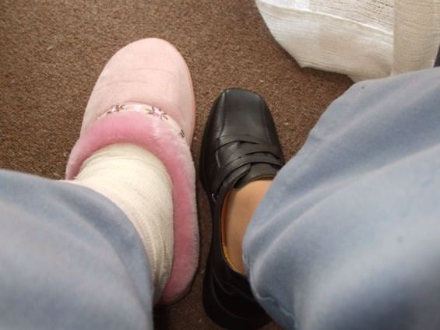
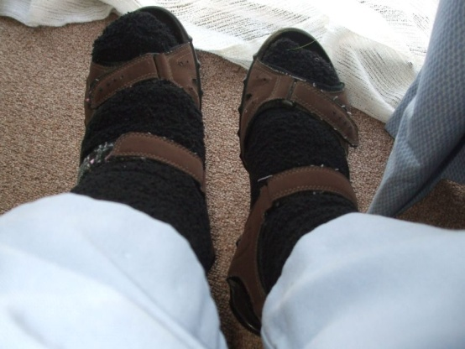
Pleading the Pink Slipper
Notes:
When do the Feetspeak feet wear the versatile Can-Do adjustable Velcro shoes and try to blend in without fuss and when do they play the sympathy vote pink slipper?
How do we distinguish when Pleading the Pink Slipper is appropriate?

Slide 2
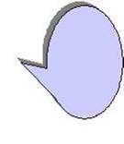

Don’t notice me or give me any extra attention I will just work quietly here

Slide 3
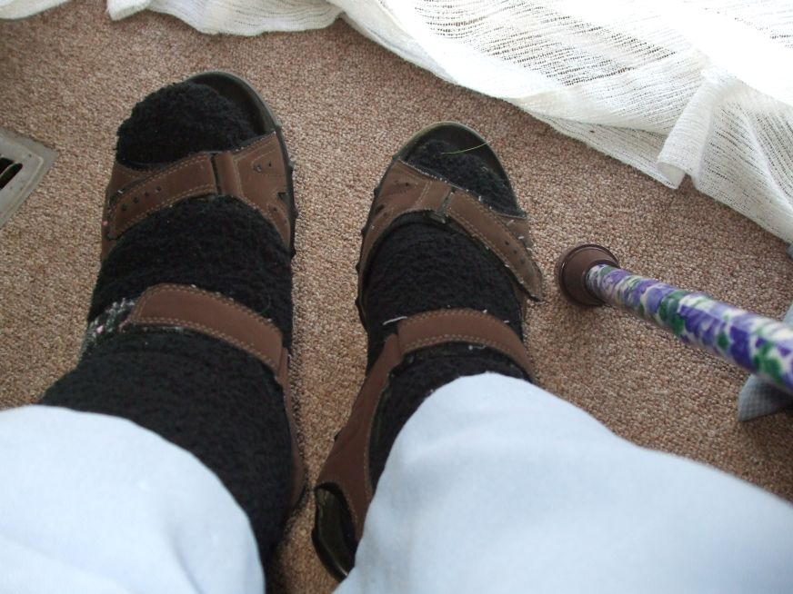
Don’t worry about me I am an autonomous learner
I have assistive technology and I know how to use it

Slide 4
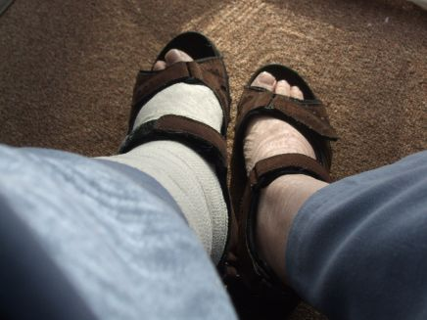
I’m trying to fit in but I am being honest and not hiding my limitations

Slide 5
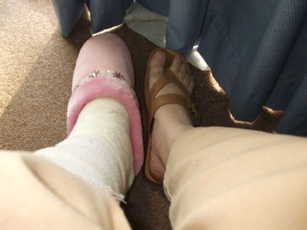
My giftedness is not being addressed so I will seek attention other ways

Slide 6
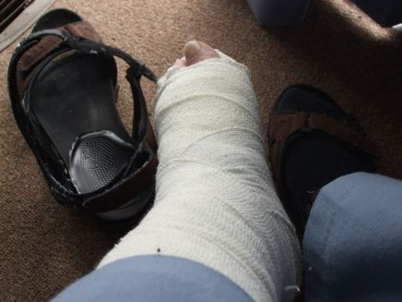
I’d like to put on a Can Do Velcro and get involved in the activities but I just can’t manage to do it!

Slide 7
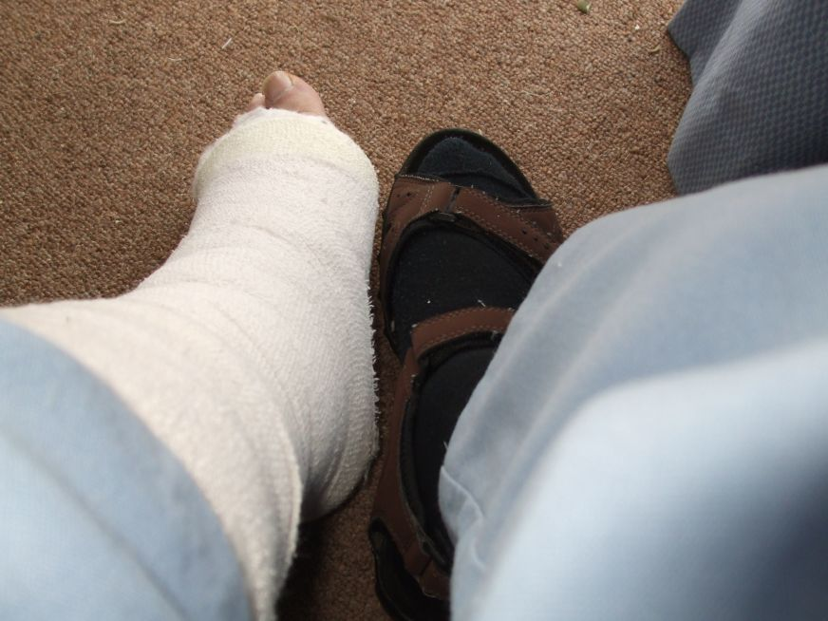
If I put on the Can Do Velcro I will want the results to be perfect Maybe I should put on the pink slipper just in case – so that I have an excuse

Slide 8
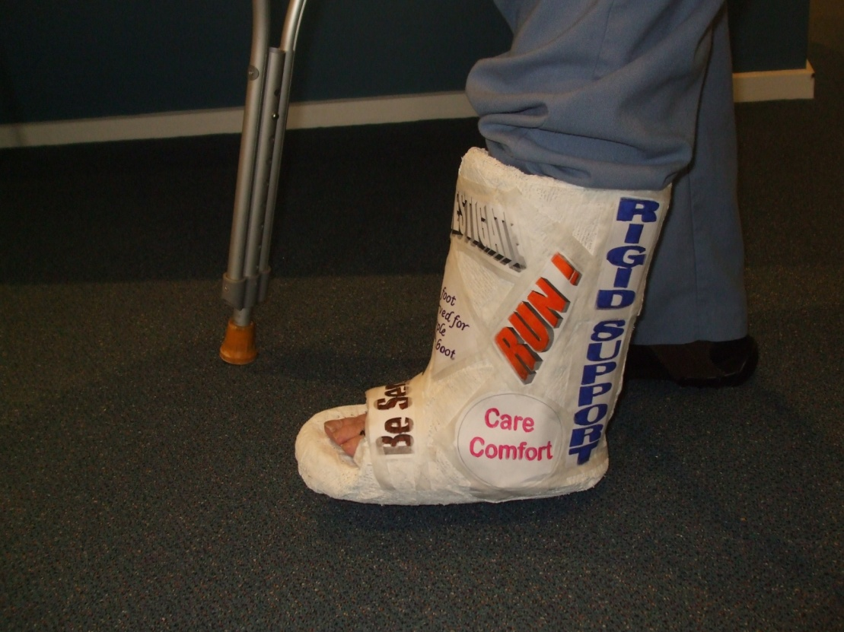
Obviously I will need to be excused from some of your formal requirements

Slide 9

I need you to know that I will not be able to meet some of your formal requirements

Slide 10
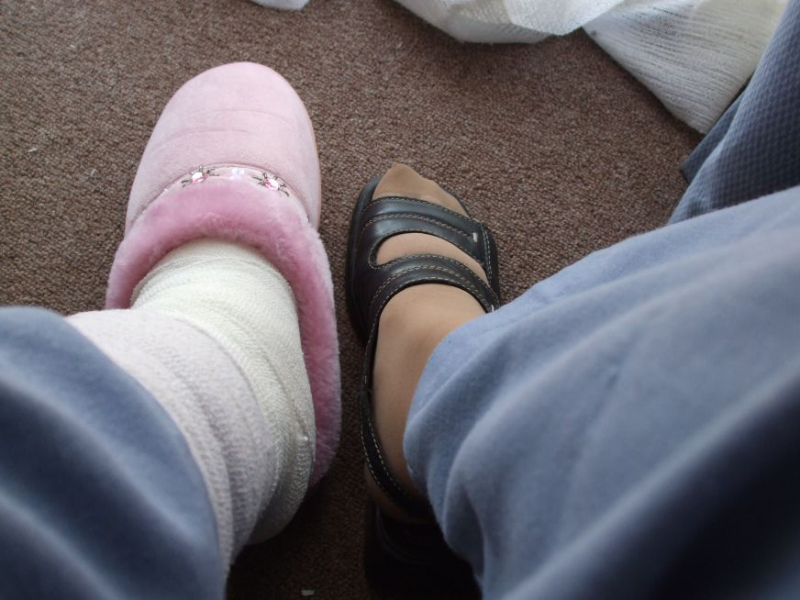
As an introduction I need you to know that I will not be able to meet some of the formal requirements during the holiday program

Slide 11
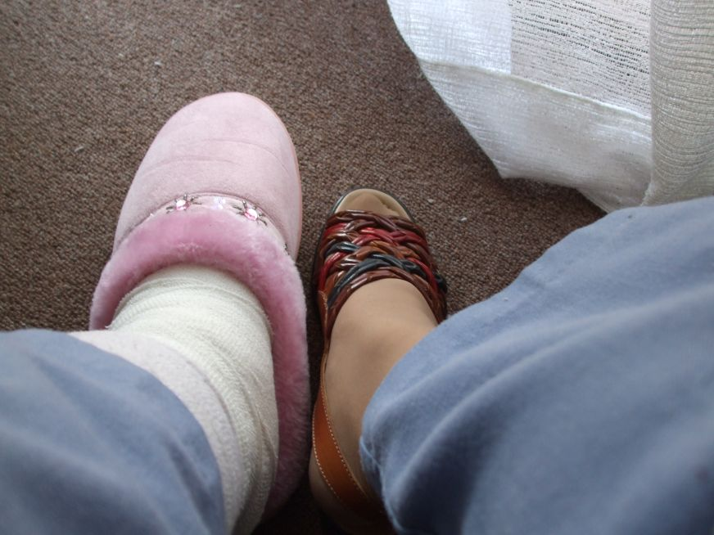
I just want to get out of the activities and have a cushion and lots of chocolate

Slide 12
What do you mean ‘malingering’?
It really does hurt!

Slide 13
It is just a coincidence that there is homework and chores to do

Slide 14
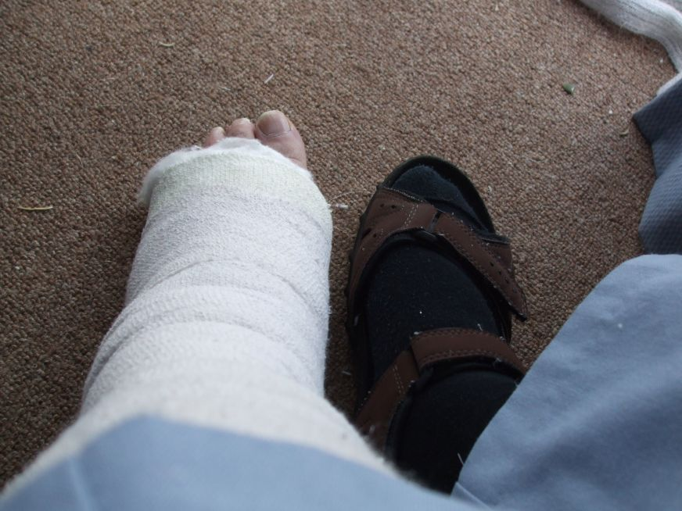
SIGH! I know I’m procrastinating I’m leaving putting on the Can Do Velcro until the last minute. It is very painful
Maybe I’ll ask for a pink slipper

Slide 15
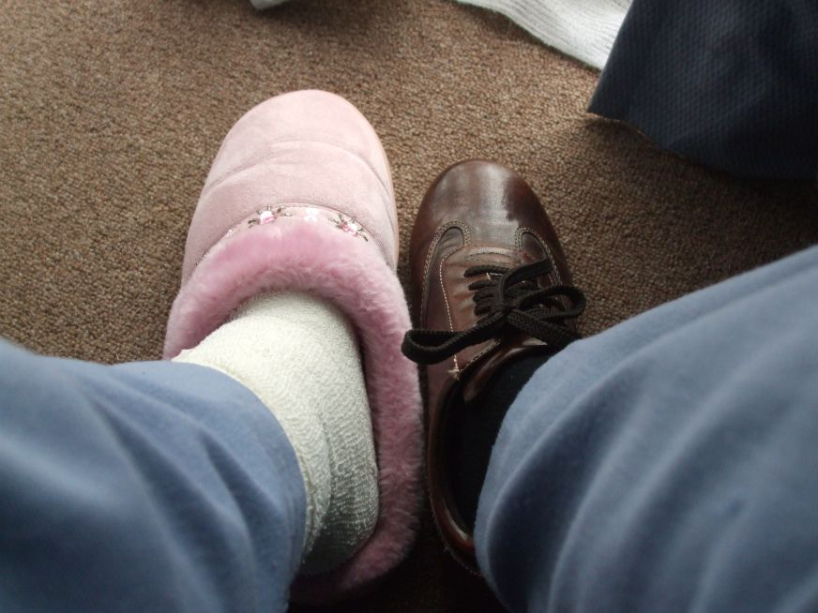
It is sensible to use all the help and support available

Slide 16
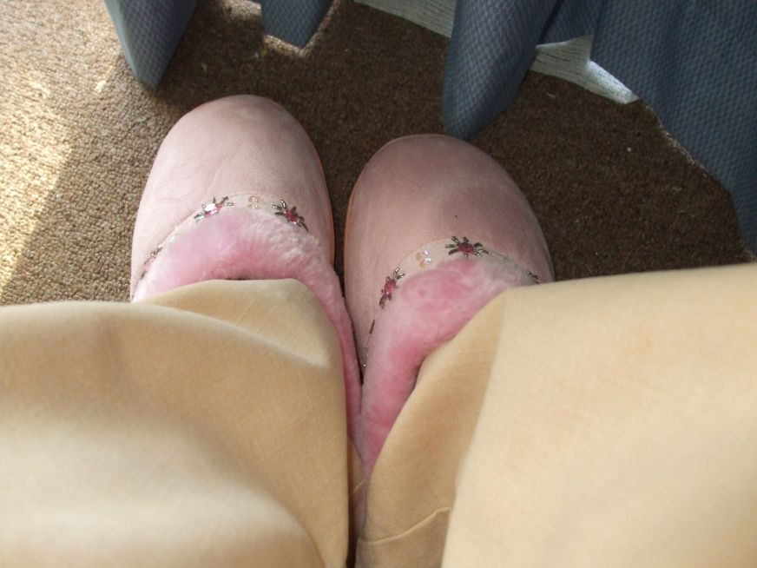
I have been out socializing each night this week so now I need an extension for the project

Slide 17
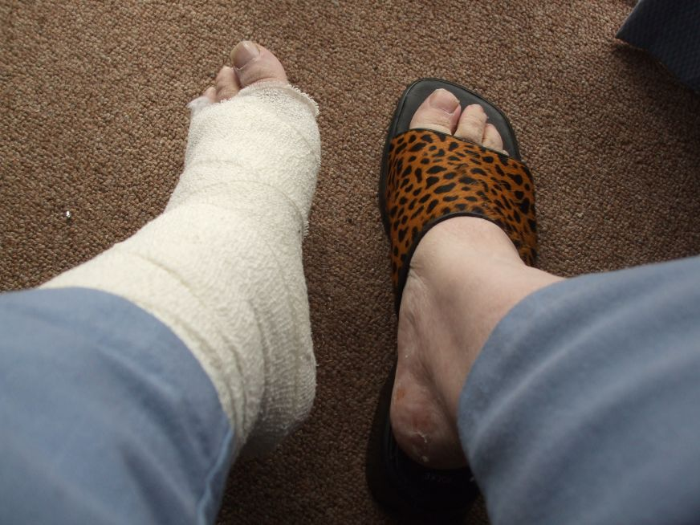
What will we be doing?
Will I need to Plead the Pink Slipper?

Slide 18

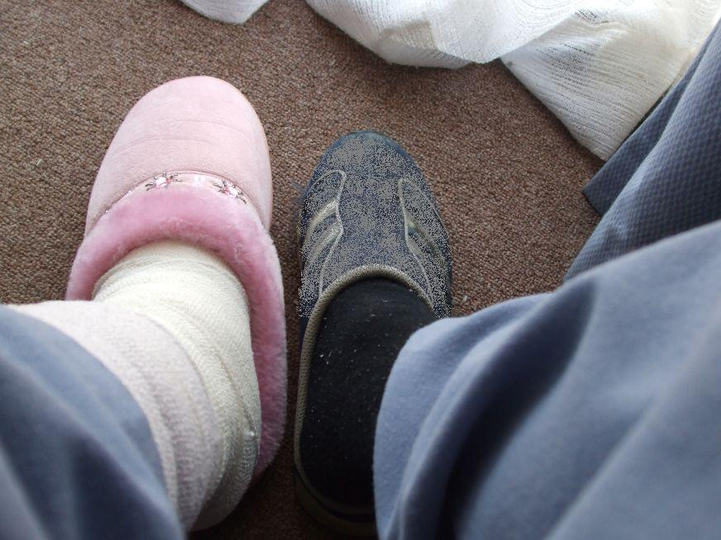
Pleading the Pink Slipper
How do you plead?

